Slide 1
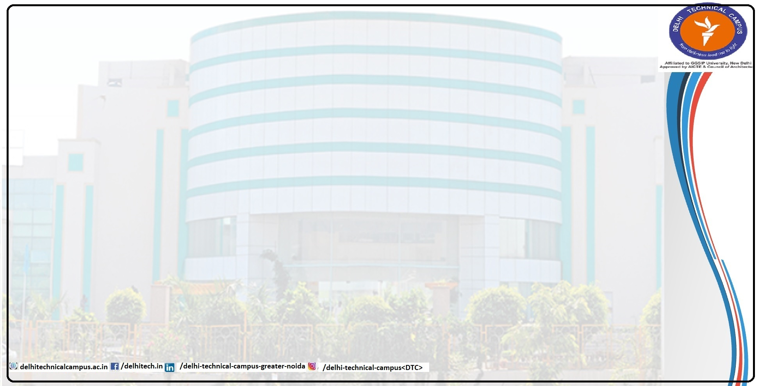
Communication Skills for Professionals
Bharti Shokeen
Non-Verbal Communication

Slide 2
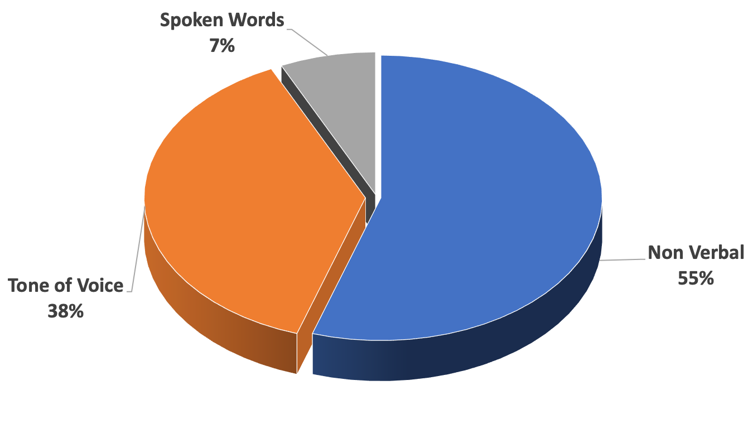
Non-Verbal Communication

Slide 3
Topics of Discussion: Non-Verbal Communication
What is Non-Verbal Communication?
What are the various types of non-verbal communication?
Characteristics non-verbal communication
Importance of non-verbal communication

Slide 4
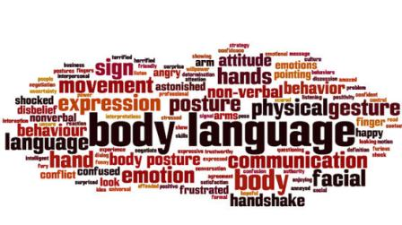
Non-verbal communication
Non-verbal language is the transmission of information through non-verbal cues like body language, gestures, posture, paralanguage and proximity.

Slide 5
Importance of Non-verbal communication
It compliments verbal communication. Non –verbal signals can strength or weaken a verbal message.
Non-verbal signals help in conveying information efficiently.
Non-verbal signals at work place enhance your ability to communicate effectively.
Non-verbal signals help in revealing truth and establish credibility.
Nonverbal communication plays a pivotal role in interpersonal communication.

Slide 6
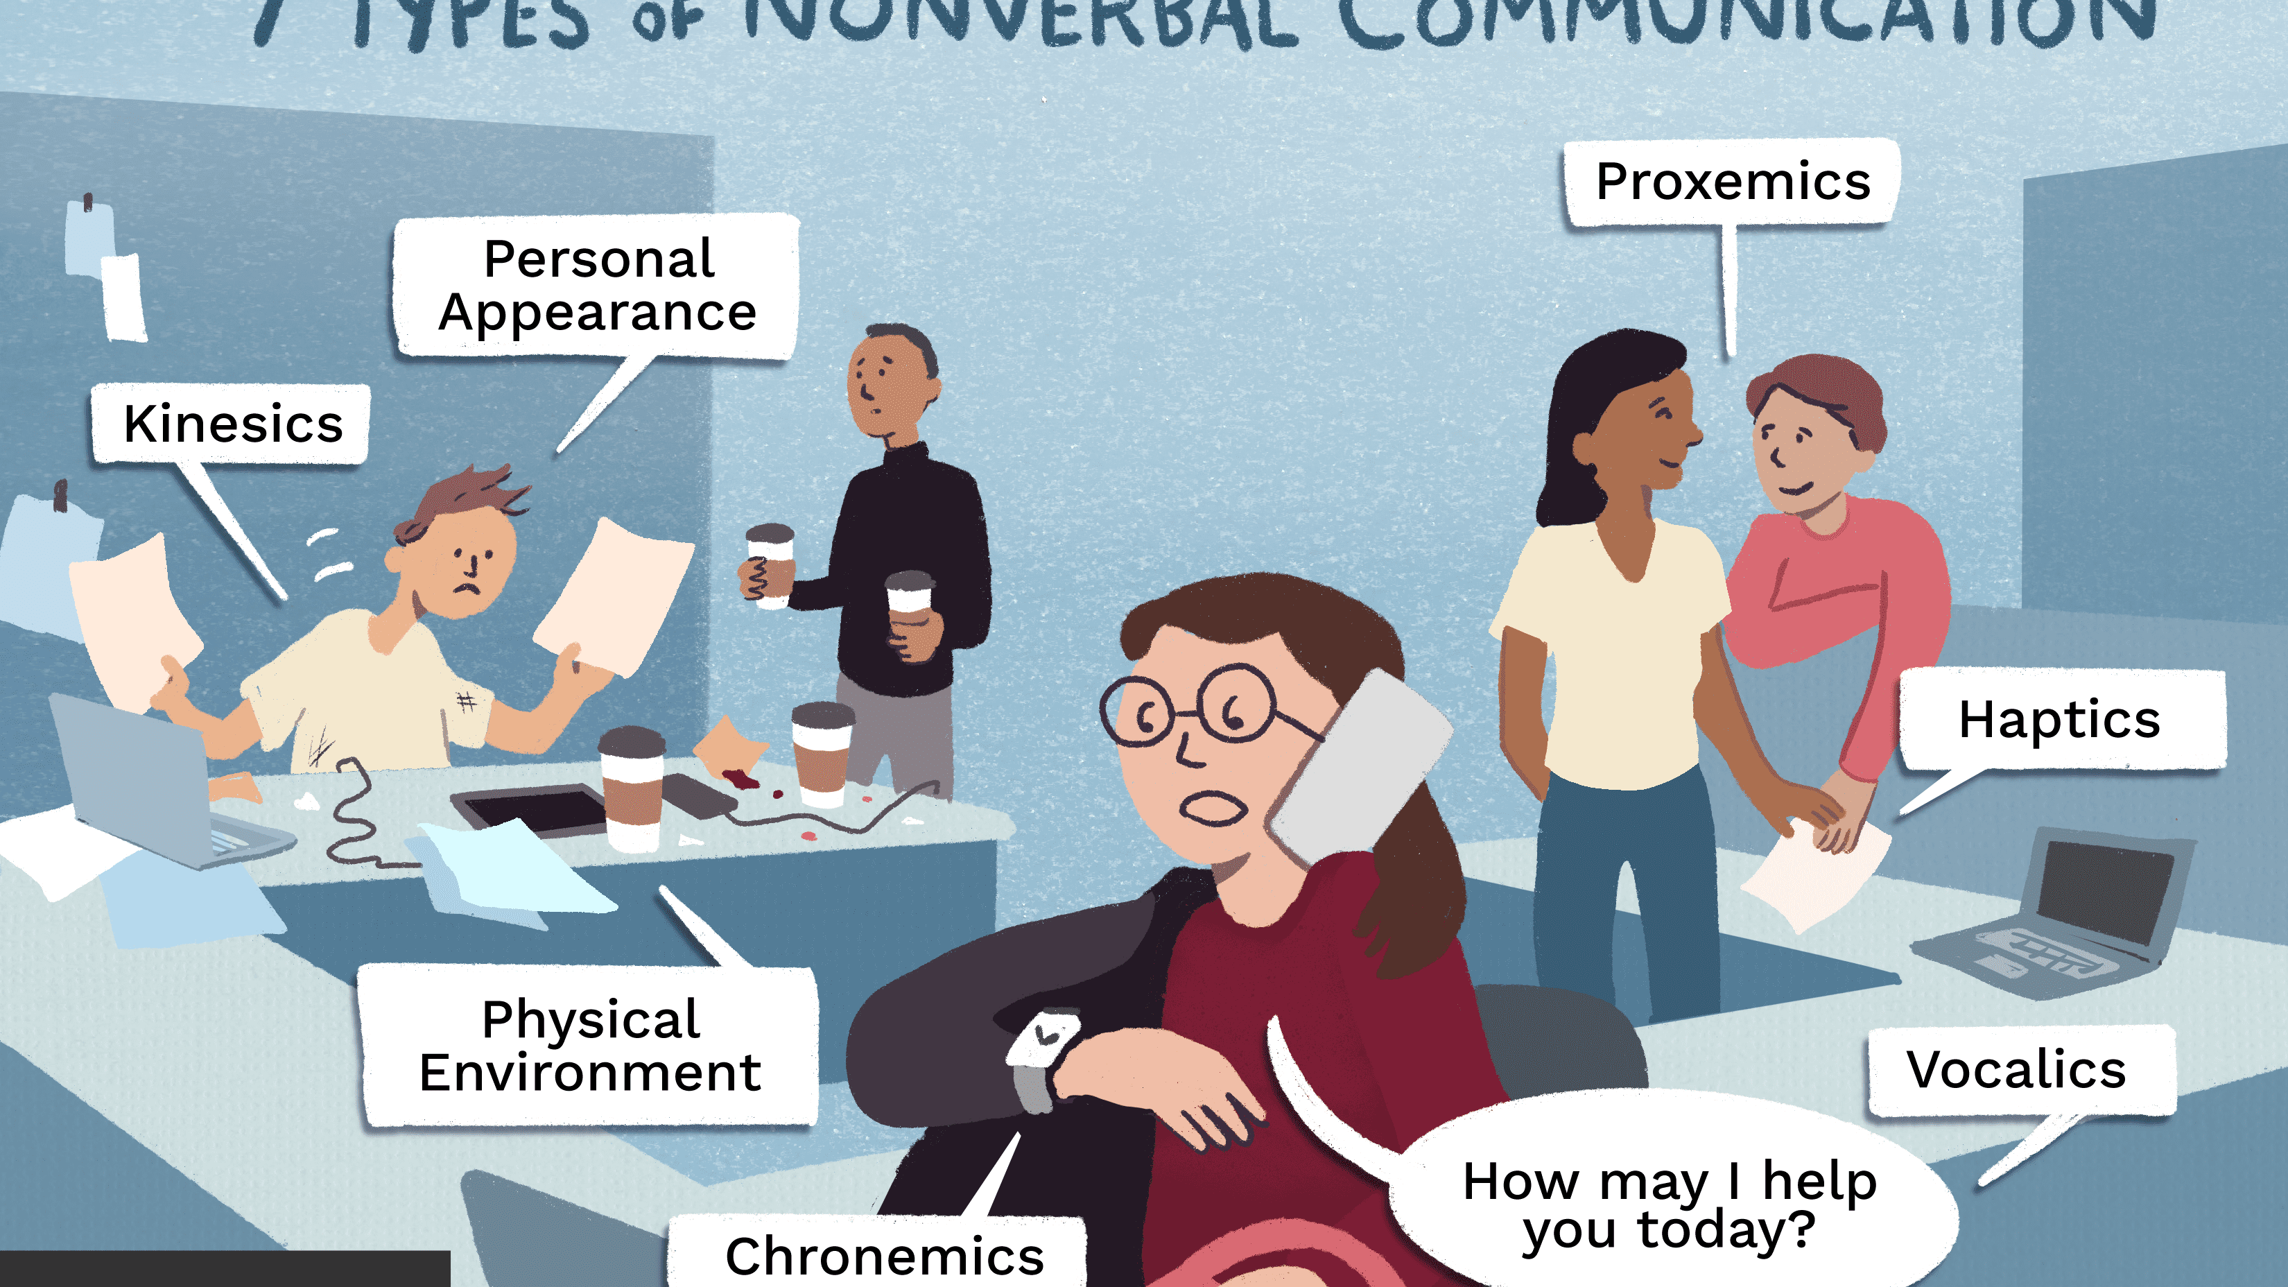
Types of Non-verbal communication
There are many nonverbal cues which we constantly use in our day to day life voluntarily and involuntarily to communicate. Some of these non verbal cues include:
Body movements/Kinesics
Voice/tone/Paralanguage
Proxemics (or closeness/personal space)
Haptics( touch)
Chronemics ( time)
Eye Movement/ Oculesics
Scent/smell/ Olfactics
Background Objects/ Iconics

Slide 7
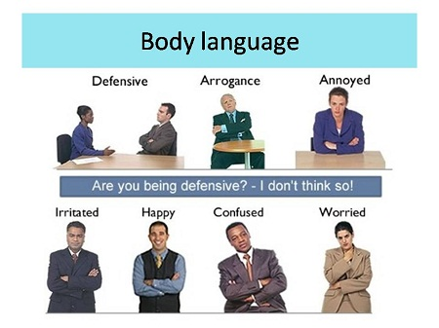
Body Language
Body language is a type of non-verbal communication in which communication is fostered consciously and unconsciously through the use of various body parts and gestures. Some of the important features of body language are:
Head movement
Facial expressions
Posture
Hand gestures
Leg and feet placement

Slide 8
Paralanguage
“It’s not what you say, it’s how you say it”
Paralanguage refers to the non-verbal elements of speech which modifies verbal communication.
Some of the aspects of Paralanguage are:
Speed: How fast or slow one speaks (e.g. completing a sentence rapidly indicates a person is nervous)
Tone: Indicates the manner of speech (e.g. appreciation can have sincere as well as sarcastic tone)
Volume: Indicates loudness of voice (e.g. when one gets angry one raises his/her voice)

Slide 9
Continued…
Pitch: Indicates the highness or lowness of voice (Generally the pitch of female voice is higher than that of males)
Articulation: It refers to the clarity in speech
Intonation: Indicates the variation in one’s pitch (e.g. stressing upon a specific word makes a sentence a question or statement)

Slide 10
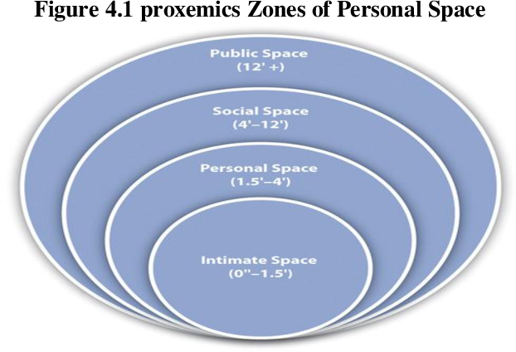
Proxemics (or closeness/personal space)
Proxemics is the study of human use of space in communication and social interaction.
It is broadly divided into four zones:
Intimate Zone: For communication with very close friends
Personal Zone: For communication with good friends or family
Social Zone: For communication with office colleagues or general acquaintances
Public Zone: For public speaking

Slide 11
Haptics (Touch)
Haptics is concerned with the use of touch as a non-verbal means of communication. Touches that can be defined as communication include handshakes, holding hands etc.
It can be classified into the following categories:
Functional/Professional – Used in professional arena
e.g. Hand Shake
2. Social – Indicates customs or traditions
e.g. Namaste
3. Friendship – Used with friends or known companions
e.g. pat on the back

Slide 12
Continued….
4. Love/Intimacy – Used to display affection
e.g. Hug
5. Violence – Indicates aggressive behaviour
e.g. Pointing a finger at someone with the intention of threatening

Slide 13
Chronemics (Time)
Chronemics is the use of ‘Time’ to communicate a message.
Chronemics classifies time into two categories:
1. Monochromatic – Based on the idea that only one thing can be done at a time and time is fragmented into smaller precise units.
Mostly prevalent in European & North American cultures.
E.g. Americans schedule their tasks & get agitated if any of the tasks runs late since it affects the subsequent activities

Slide 14
Chronemics (Time)
2. Polychromatic – Based on the idea several things can be done at once and broader view of time is considered
- Prevalent mostly in Latin American, South Asian (Indian), African cultures
- E.g. An Indian does not prepare a schedule for the day and takes up tasks as and when they arrive.

Slide 15
Functions of Non-verbal communication
Substitution: It can substitute for a verbal message. Eg: Narrowing your eyes to show suspicion.
Complementing: It adds to or complement verbal message. Eg: Pat on the back
Accenting: It underlines or amplifies a verbal message . Eg: Pounding the table.

Slide 16
Continued…
Repetition: It repeats and in turn strengthens the message you’re making verbally. Eg: Saying “yes” and nodding your head at the same time.
Contradiction: It can contradict the verbal message you’re trying to convey. Eg: Struggling to make eye contact while speaking the truth.

Slide 17
Case Study on non-verbal communication
Video: Mind Your Language: Season 2 Episode 1
How do the nonverbal signals vary across cultures & affect communication?
Discuss how non-verbal signals strengthen or weaken communication in this video?
How can we improve non-verbal communication while communicating with people fro different cultures?

